Slide 1
Household-Centered Care Coordination
Florida Health Literacy Summit
Nemours Children's Hospital Orlando
January 20, 2017
David Brown, MD, FAAFP
Vice Chair of the Department of Humanities, Health and Society
Chief of Family Medicine
Herbert Wertheim College of Medicine

Slide 2
Herbert Wertheim College of Medicine
Graduated first class 2013
Public university
Educational mission
Community oriented
Social determinants of health (SDOH)
Ethics & Policy
Service Learning

Slide 3
Social Determinants – Care Coordination
Nutrition & Food Security
Healthcare
Technology
Legal
Psycho-Social-Cultural
Transportation
Employment
Life Skills and Education
Income
Housing
Health Risk Profile

Slide 4
Coordination Framework
Policy and Built Environment / State and Federal Government
Outreach Policy Coordinators
Outreach Coordinators
Community Partners
Medical, Social, Behavioral, and Law Services
Mobile Health Centers,
Health Law Clinic
Outreach Specialists
&
Interprofessional Teams
Household

Slide 5
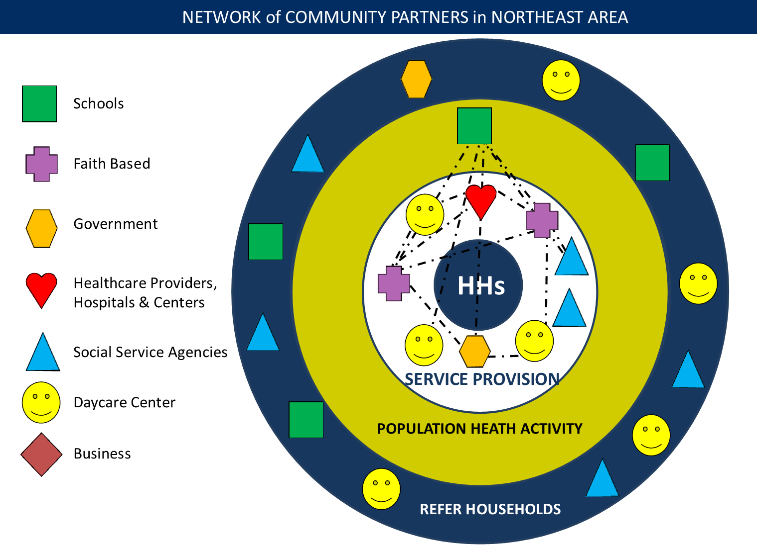
Network of Community Partners

Slide 6
Household Centered Team
Household
Medicine
Social Work
Nursing
Education
Public Health
Physician Assistant
Law
Outreach

Slide 7
Integrated Care
Household
Medical
Behavioral
Legal
Educational
Social

Slide 8
Service Learning
Household Centered Care
SDOH / Population Health
Interprofessional Teams
Longitudinal Experience
Continuity of Care
Reflection

Slide 9
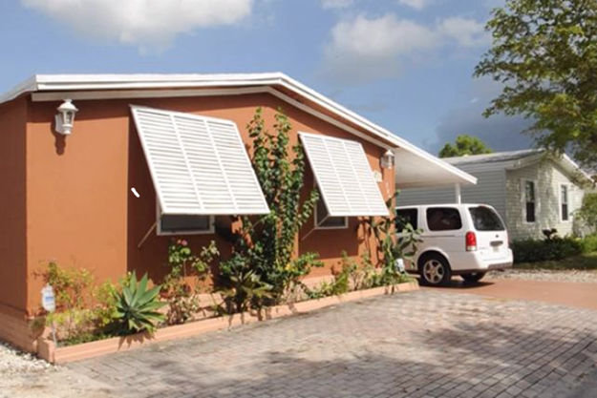
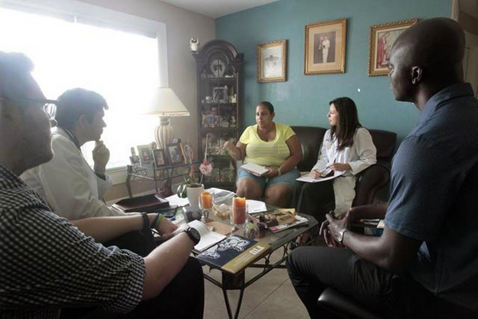
The first six years of NeighborhoodHELP™
1,470 students
7,452 visits
848 households
2,252 members
1,021 household members
7,207 mobile health center visits
Households received a variety of free educational, preventive, social, behavioral, primary care and coordination services

Slide 10
Medical-Legal Partnership
1,403 legally remediable SDOHs identified
35% for health care access issues
19% immigration
19% family stability
17% financial stability
10% housing
Secured $520,000 in direct financial benefits for households
(e.g. disability payments, negotiated debt reduction)

Slide 11
Student Reflections
“My household fell into the insurance gap…too much money for Medicaid but not enough to make subsidized insurance affordable.”
“The lack of a central cooling system was immediately noticeable.”
“ The neighborhood is rundown but lively…[with] homes with anti-burglary bars in their windows.”
“The main social issue she has been dealing with is the fact that she is an undocumented resident.”

Slide 12
Readmission Healthcare Costs
Nearly 1 in 5 Medicare patients -2.6 million senior citizens - discharged from the hospital are readmitted within 30 days at a cost of more than 26 Billion annually.
-Center for Medicare and Medicaid 2015
Our readmission rate with uninsured patients at the public hospital was reduced from 35% to 14% with this approach.

Slide 13
South Miami Emergency Department Utilization Pilot
34 individuals referred to NeighborhoodHELP in 2015 due to frequent Emergency Department Visits at South Miami Hospital
ED visits by year
2014 | 2015 | 2016
92 | 79 | 53

Slide 14
Current Focus
Integrated Care
Entrustable Professional Activities
Value-Based Care
Health Risk Profile
Business Intelligence
Social Determinants Dashboard

Slide 15
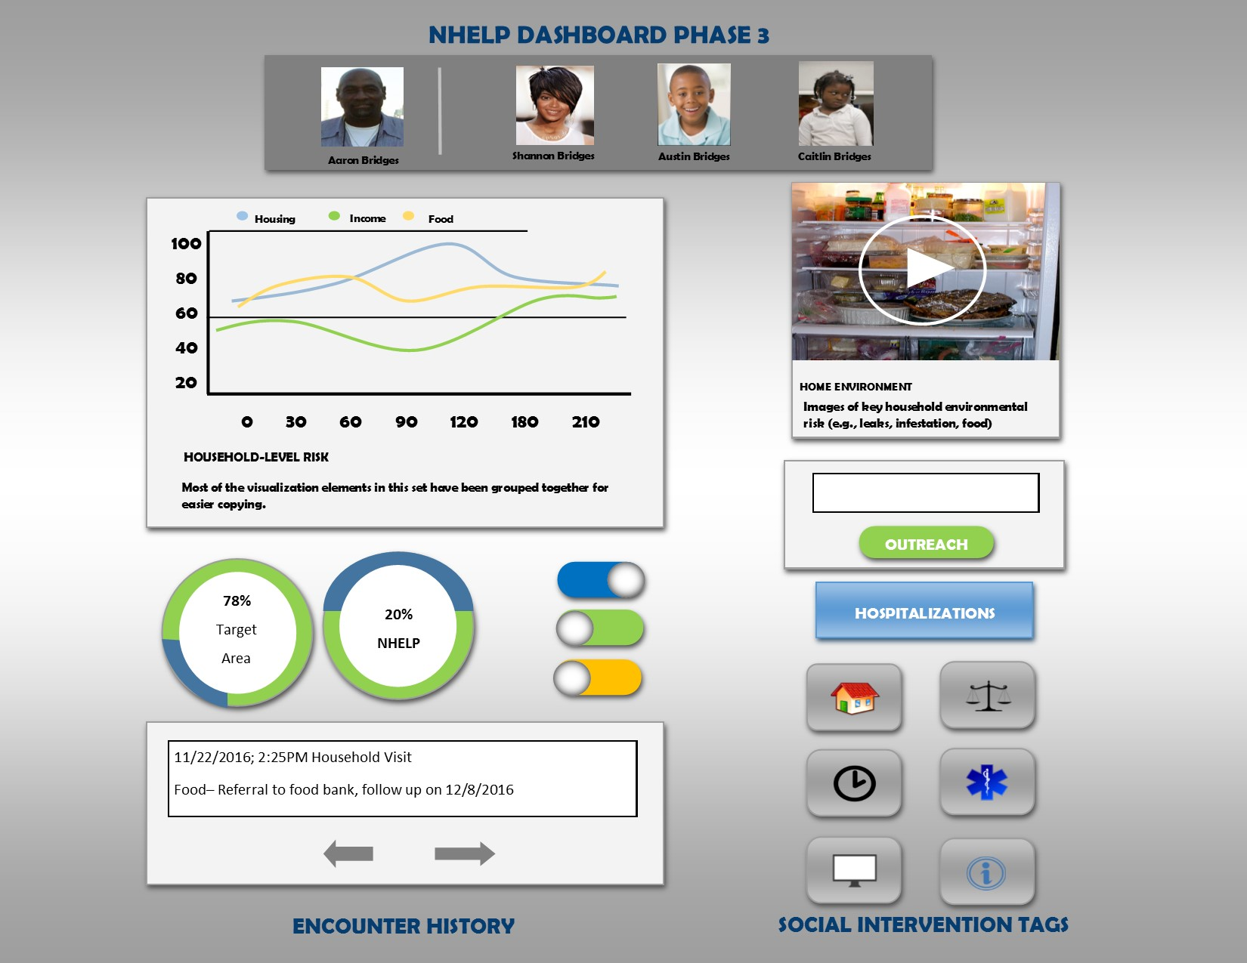
Social Dashboard

